Slide 1


International Salmon Data Laboratory
First Workshop Vancouver 2019-01-25
Scott Akenhead
Pacific Biological Station scott@s4s.com 1.250.210.4410
Notes:
Why am I here talking about salmon.

Slide 2
Background
60% of all mammals are livestock, 36% are humans, 4% are wild.
Biomass of broiler chickens > all wild birds.
60% of vertebrates lost since 1970.
83% of freshwater animals lost since 1970.
7.6×10⁹ humans @ >3×10⁹ century⁻¹.
Anthropic global warming rate: 0.034 ℃ a^{-1.}
Run-away global warming?
Notes:
https://www.theguardian.com/environment/2018/may/21/human-race-just-001-of-all-life-but-has-destroyed-over-80-of-wild-mammals-study
https://c402277.ssl.cf1.rackcdn.com/publications/1187/files/original/LPR2018_Full_Report_Spreads.pdf

Slide 3
Background
Epic fail.
Extinction event fail.
Ecologists failed.
You failed.
Last chance?
Notes:
q. https://www.theguardian.com/environment/2018/may/21/human-race-just-001-of-all-life-but-has-destroyed-over-80-of-wild-mammals-study

Slide 4
Salmon Ecologists Failed
Atlantic Salmon, Chinook, Coho, and Steelhead
declining, everywhere.
we do not know why.
Sockeye Salmon are thriving
only at northern edge of previous range.
Chum Salmon have an enormous biomass
largely from hatcheries.
Pink Salmon
own the world.

Slide 5
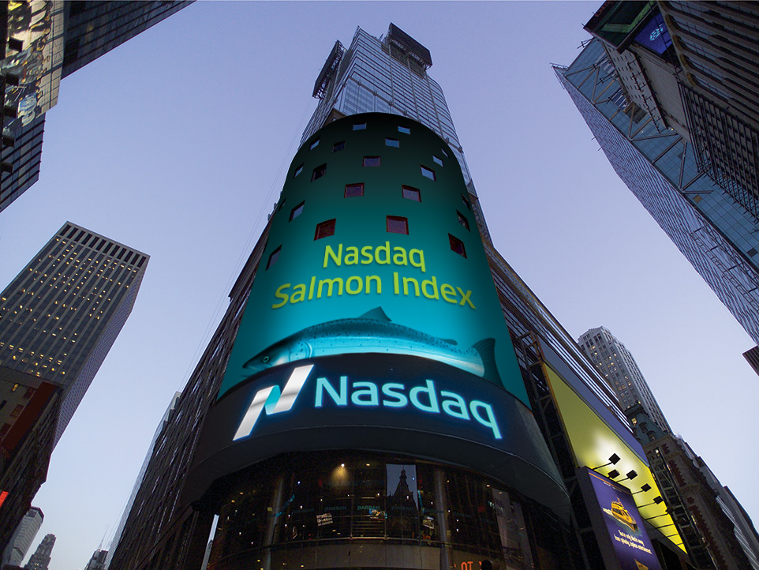

Slide 6
Salmon are Resilient.
Overarching Goal of IYS
Survive surprise.
So: Salmon systems are resilient.
So: Management is nimble.
So: Decisions are fast and smart.
So: Information flow is much better.
So: How? Exactly?

Slide 7
How, Indeed.
“Bottom line is that there are
NOT enough corners of desks
for this to sit on with existing staff
who have the necessary
breadth and depth of understanding
to actually deliver the work.”
- Richard Bailey, DFO. 2018-09-14

Slide 8
Knowledge Flow
“...sustainable ecosystem management depends strongly on the acquisition and use of integrated systems of knowledge that continuously replace outmoded techniques as our understanding evolves.
Unobstructed knowledge flow between science and management is particularly important in times of significant change…"
Roux, D. J., K. H. Rogers, H. C. Biggs, P. J. Ashton and A. Sergeant. 2006. Bridging the science– management divide: moving from unidirectional knowledge transfer to knowledge interfacing and sharing. Ecology and Society 11:4. http://www.ecologyandsociety.org/vol11/iss1/art4/
Notes:
"Today, more than ever, we recognize that sustainable ecosystem management depends strongly on the acquisition and use of integrated systems of knowledge that continuously replace outmoded techniques as our understanding evolves. Unobstructed knowledge flow between science (often considered the arena of the “experts”) and management (similarly seen as the domain of “decision makers”) is particularly important in times of significant change, such as policy reform and implementation."
Roux, D. J., K. H. Rogers, H. C. Biggs, P. J. Ashton and A. Sergeant. 2006. Bridging the science– management divide: moving from unidirectional knowledge transfer to knowledge interfacing and sharing. Ecology and Society 11:4. http://www.ecologyandsociety.org

Slide 9
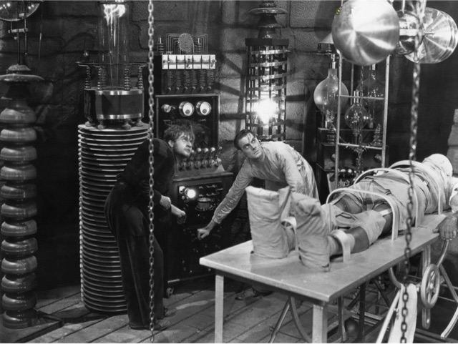
TECHNOLOGIST
ECOLOGIST
ISDL

Slide 10
“In other studies you go as far as other have gone before you, and there is nothing more to know; but in a scientific pursuit there is continual food for discovery and wonder.”
“How many things are we upon the brink of discovering if cowardice or carelessness did not restrain our inquiries?”
― Mary Wollstonecraft Shelley. 1818. Frankenstein; Or, The Modern Prometheus. (written at age 18)
Notes:
“In other studies you go as far as other have gone before you, and there is nothing more to know; but in a scientific pursuit there is continual food for discovery and wonder.”
“How many things are we upon the brink of discovering if cowardice or carelessness did not restrain our inquiries?” [scientific sins?]
― Mary Wollstonecraft Shelley. 1818. _Frankenstein; Or, The Modern Prometheus._ (written at age 18)

Slide 11
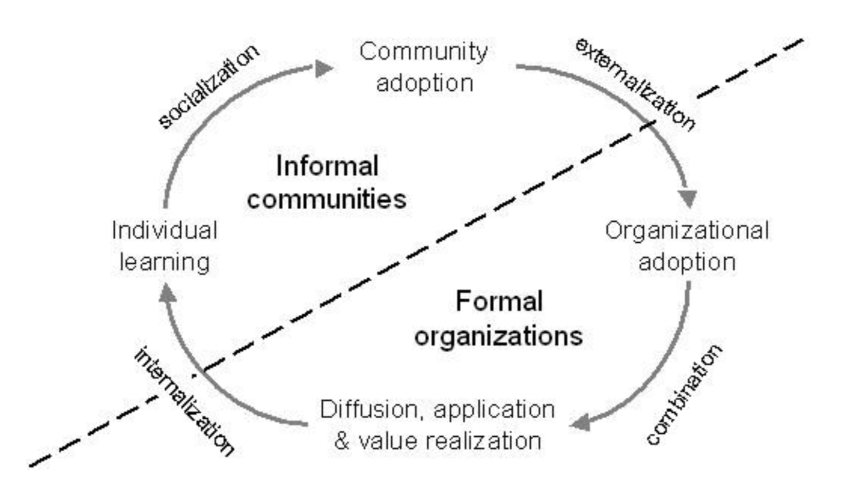
Knowledge Growth
Roux, D. J., K. H. Rogers, H. C. Biggs, P. J. Ashton and A. Sergeant. 2006. Bridging the science– management divide: moving from unidirectional knowledge transfer to knowledge interfacing and sharing. Ecology and Society 11:4. http://www.ecologyandsociety.org/vol11/iss1/art4/
Notes:
Roux, D. J., K. H. Rogers, H. C. Biggs, P. J. Ashton and A. Sergeant. 2006. Bridging the science– management divide: moving from unidirectional knowledge transfer to knowledge interfacing and sharing. Ecology and Society 11:4. http://www.ecologyandsociety.org/vol11/iss1/art4/

Slide 12


Slide 13
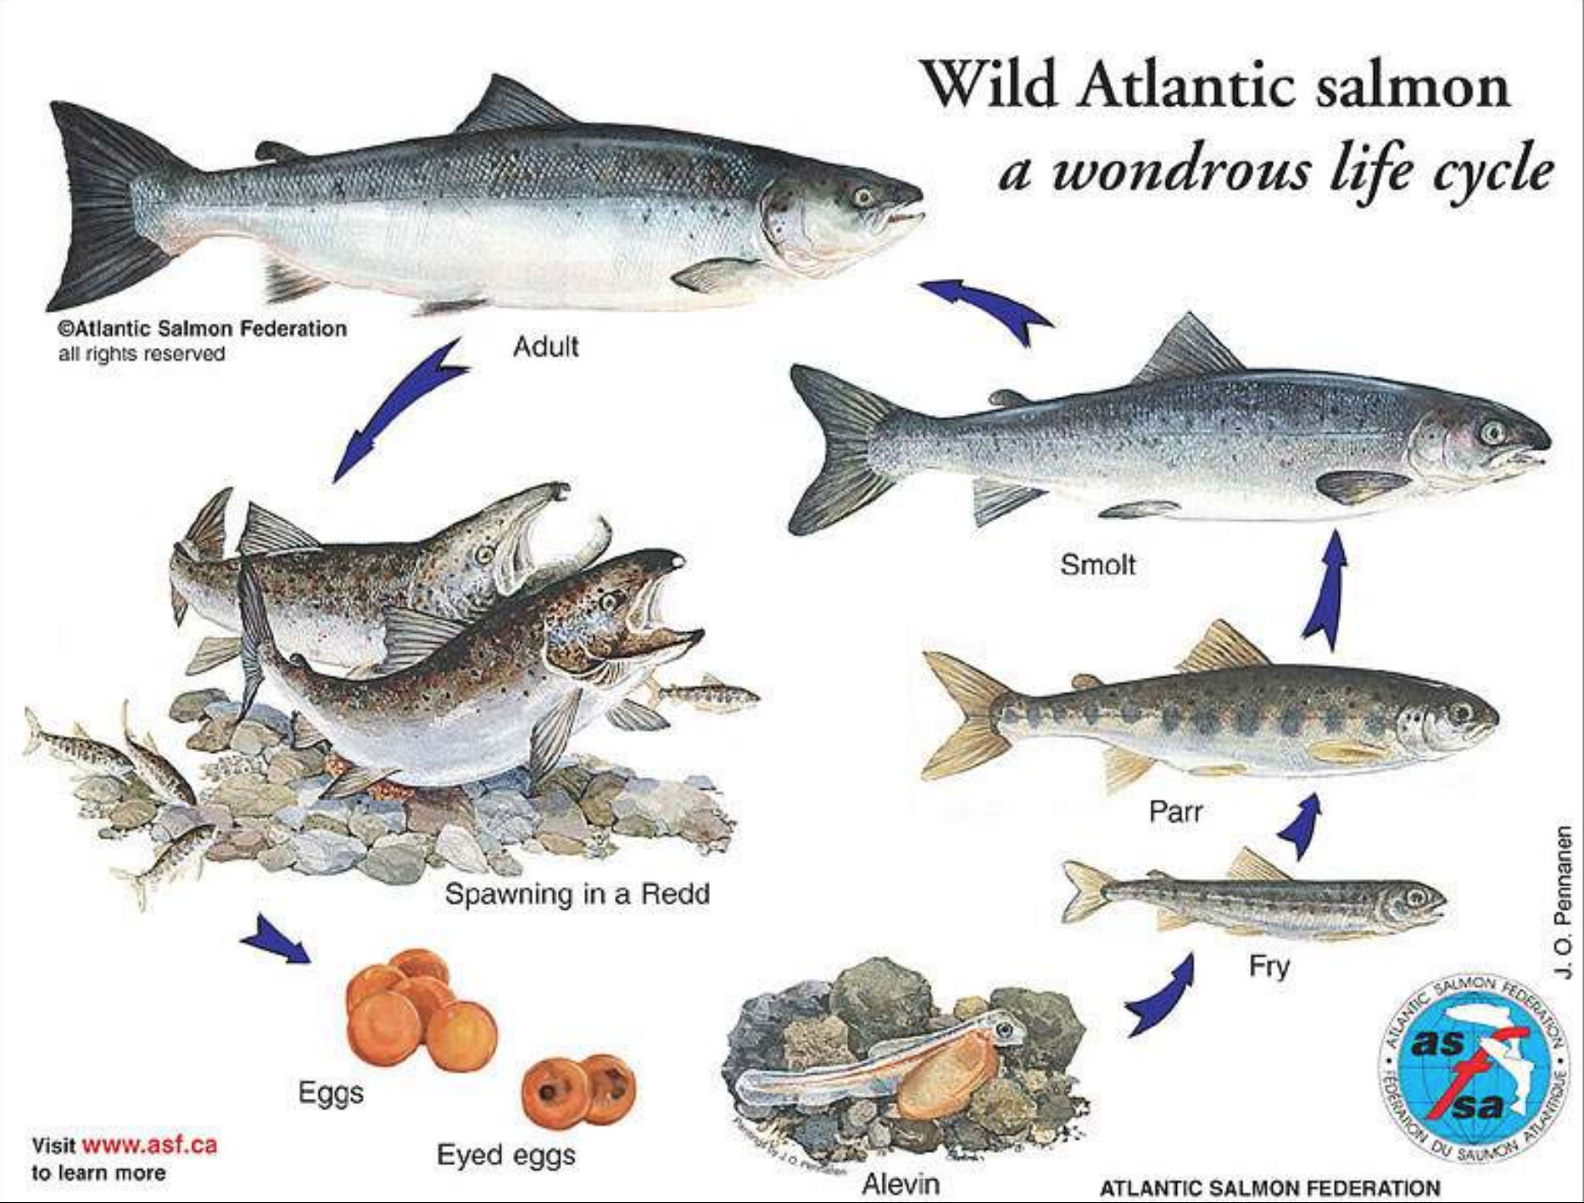

Slide 14
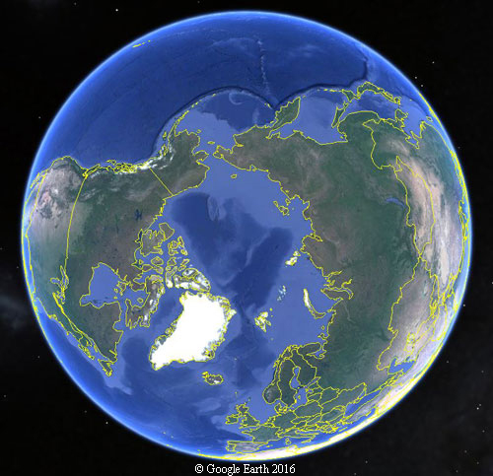

Problem
Salmon impacted by climate change
Objective
Predict & mitigate climate change effects
Barrier
Data scattered across countries, languages, systems, methods,…
Solution
New tools for data flow & decisions
Outcome
Salmon are resilient, “survive surprise”
Barrier
Adoption of new practices

Slide 15
What will this look like?
A collaboration on new tools for salmon data assembly, analysis, and visualization
—that are powerful, easy-to-use, safe, effective, and rewarding.

Slide 16
Your work can impact this.
we need
Irresistible examples, thus
Technology and tool builders, thus
Support for your participation, and
Support for end-users.

Slide 17
International Salmon Data Laboratory

Slide 18
New best practices:
Radically better information flow and knowledge management.
graphs for good
Data mobilization
We actually know what we should know from the data we collected.
data to decisions

Slide 19
What tools are needed?
Assemble Data
access
describe
clean
load
Integrate & Analyze
models
statistics
workflow
automate
Decision
Support
data viz.
info- graphics
Collaboration Support

Slide 20
Salmon problems are specific.
Salmon solutions are general.
Data mobilization
Resilience and agility
Implementation of new tools
Informed decisions
Repay participants by sharing

Slide 21
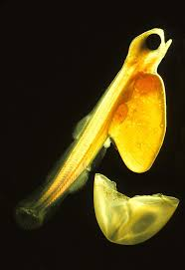
International Salmon Data Laboratory
The revolution begins with salmon
and you.
Credit: Uwe Kils, ecoscope.com

Slide 22
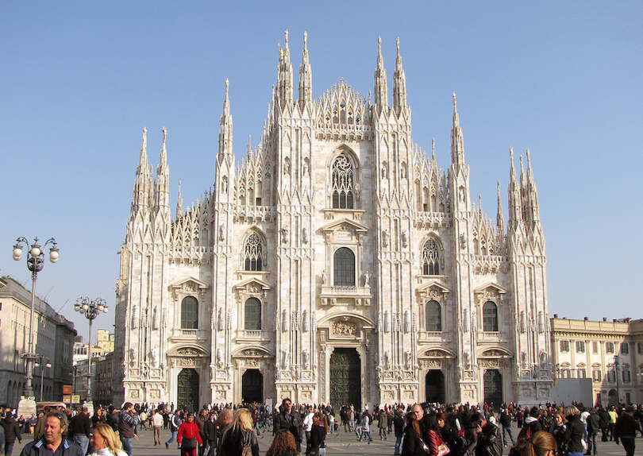
Duomo di Milano
started:1386
finished: 5 centuries
Notes:
An exceptionally large and elaborate Gothic cathedral on the main square of Milan, the Duomo di Milano is one of the most famous buildings in Europe. It is one of the largest Gothic cathedrals in the world. Construction began in 1386 under Archbishop Antonio da Saluzzo in a Late Gothic style more typically French than Italian. It took five centuries to complete the famous cathedral.

Slide 23
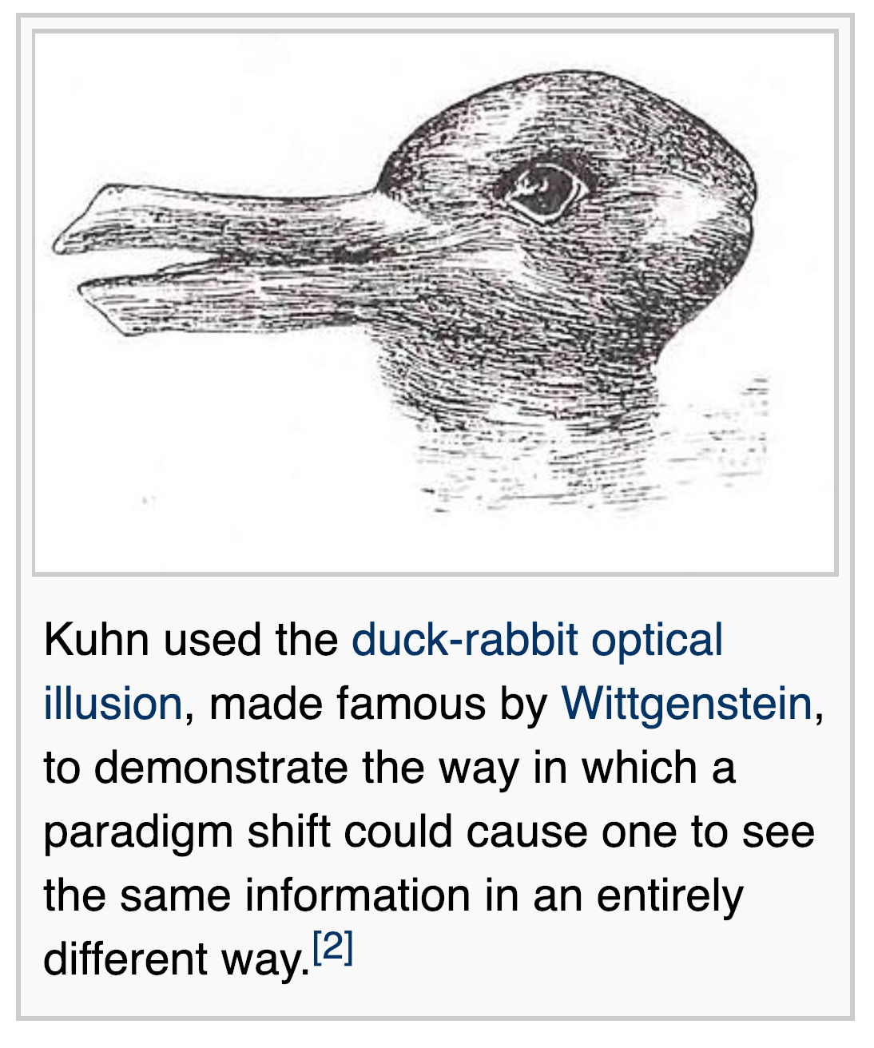
Notes:
https://en.wikipedia.org/wiki/Paradigm_shift Kunh 1962 The Structure of Scientific Revolutions. Also Kant 1787 A critique of Pure Reason.

Slide 24
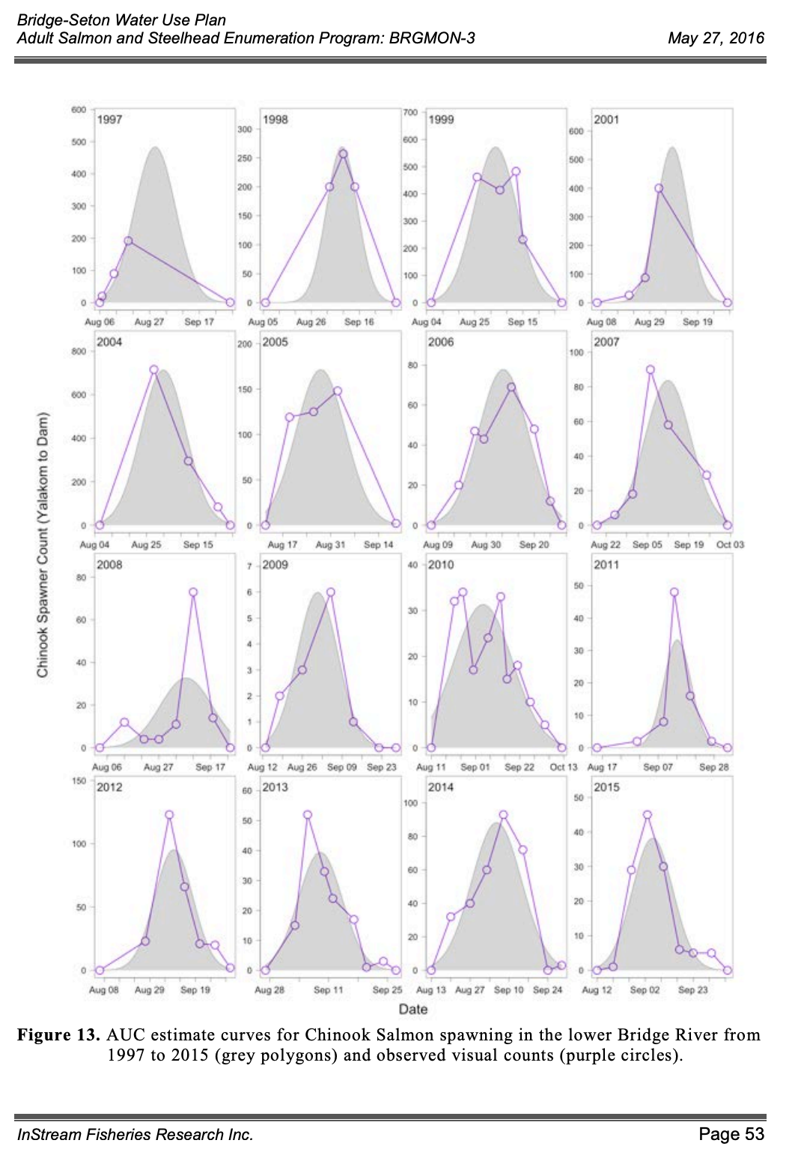
Notes:
Nicholas Burnett, Daniel Ramos-Espinoza, and Douglas Braun. 2016. Bridge River Project Water Use Plan
Lower Bridge River Adult Salmon and Steelhead Enumeration, Implementation Year 4, Study Period: April 1 2015 to March 31 2016.
BC Hydro Report, reference: BRGMON-3. InStream Fisheries Research Inc., 215 – 2323 Boundary Road, Vancouver, BC, V5M 4V8.

Slide 25
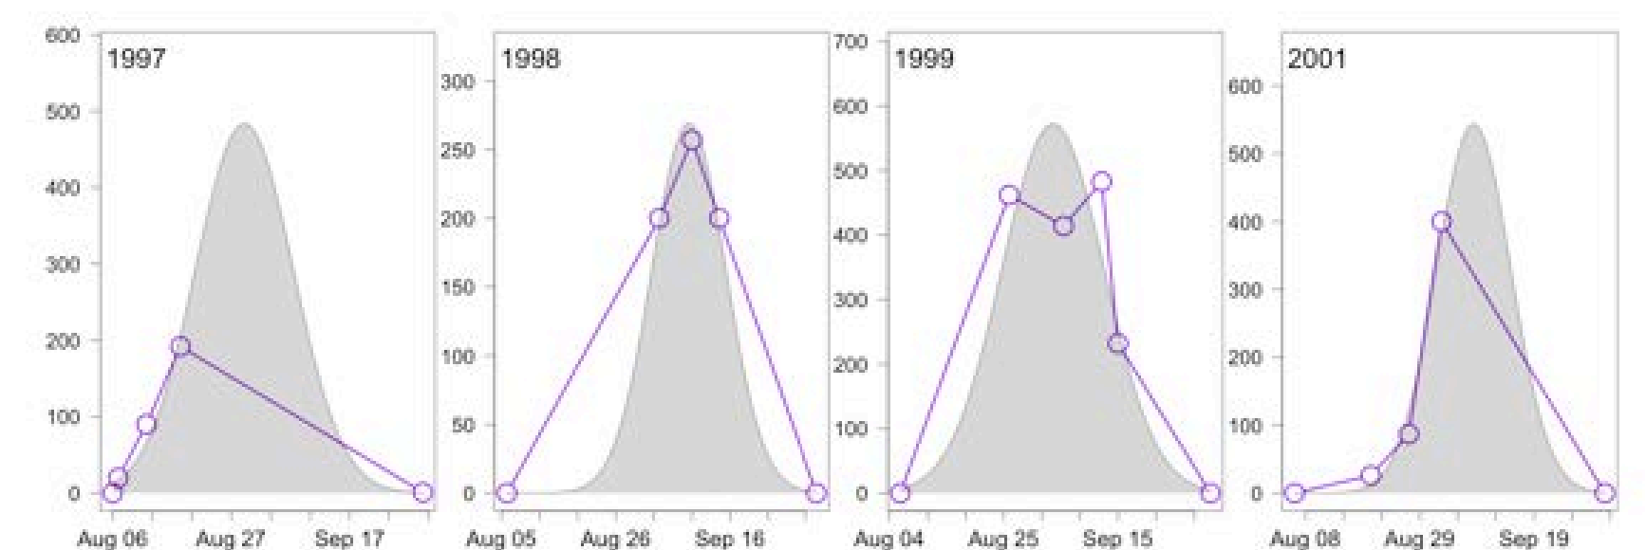

Slide 26
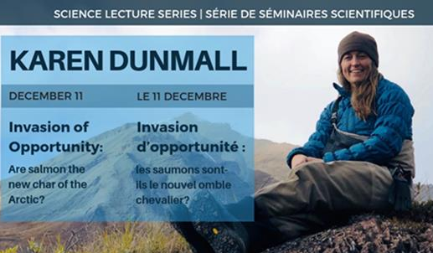
The largest community-led initiative monitoring fish biodiversity in the Canadian Arctic.
Wild salmon are expanding across the Canadian Arctic. Indigenous Peoples are harvesting them in places where salmon had never been seen.
Dr. Dunmall’s project draws on local knowledge to identify salmon origins, predict where they might colonize, and assess interactions with local Arctic fishes.

Slide 27
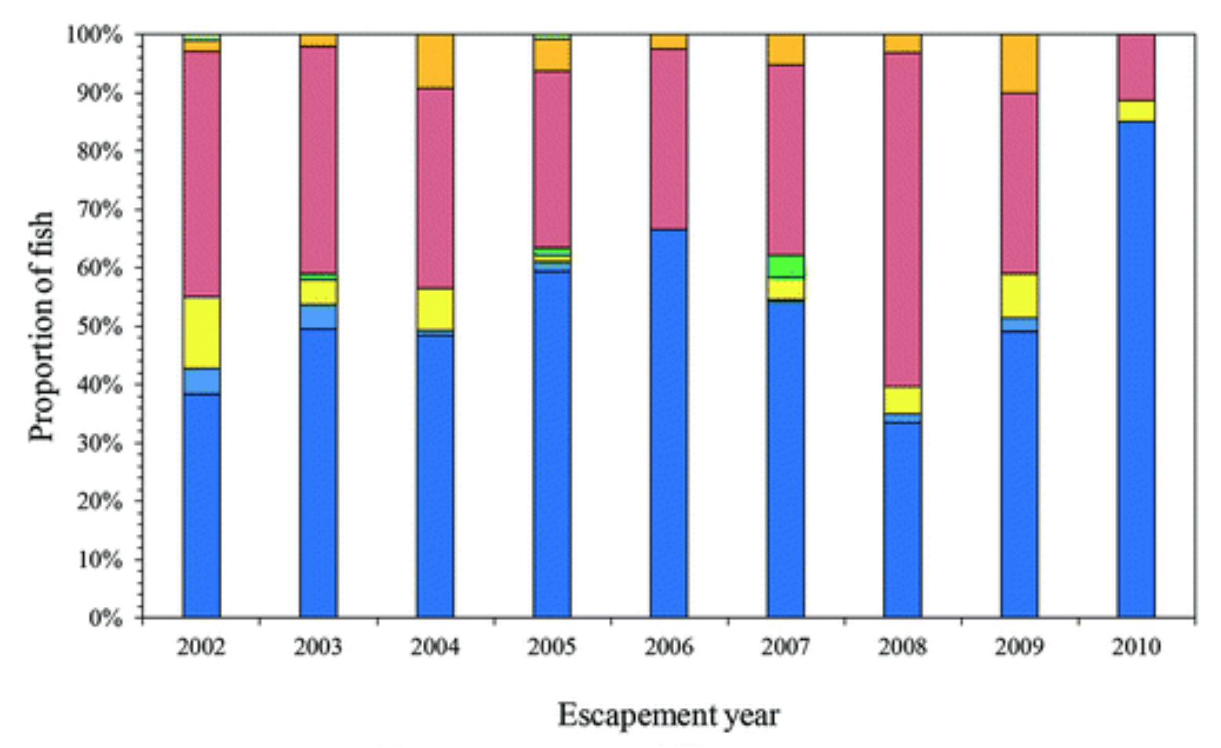
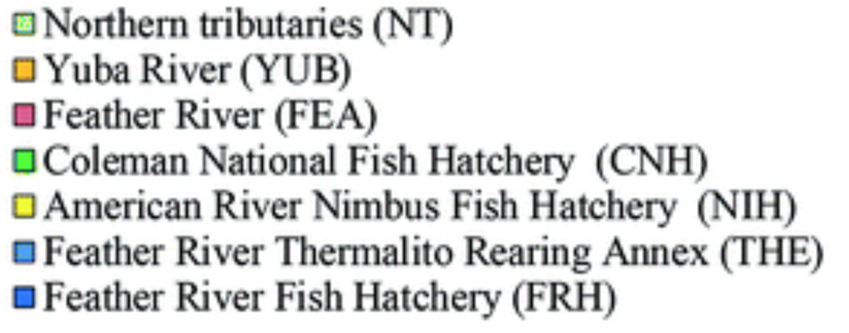
Wild
Hatchery
"Owing to the continued declines in wild salmon abundance, lack of hatchery management reform, and impending climate change, the fate of wild salmon in California are in jeopardy, and extinction in the wild is deemed likely if drastic management actions are not taken."
Notes:
"Owing to the continued declines in wild salmon abundance, lack of hatchery management reform, and impending climate change, the fate of wild salmon in California are in jeopardy, and extinction in the wild is deemed likely if drastic management actions are not taken."
Malte Willmes,James A. Hobbs, Anna M. Sturrock, Zachary Bess, Levi S. Lewis, Justin J.G. Glessner, Rachel C. Johnson, Ryon Kurth, Jason Kindoppe. 2018. Fishery collapse, recovery, and the cryptic decline of wild salmon on a major California river.
Canadian Journal of Fisheries and Aquatic Sciences. 75(11):1836-1848 https://doi.org/10.1139/cjfas-2017-0273

Slide 28
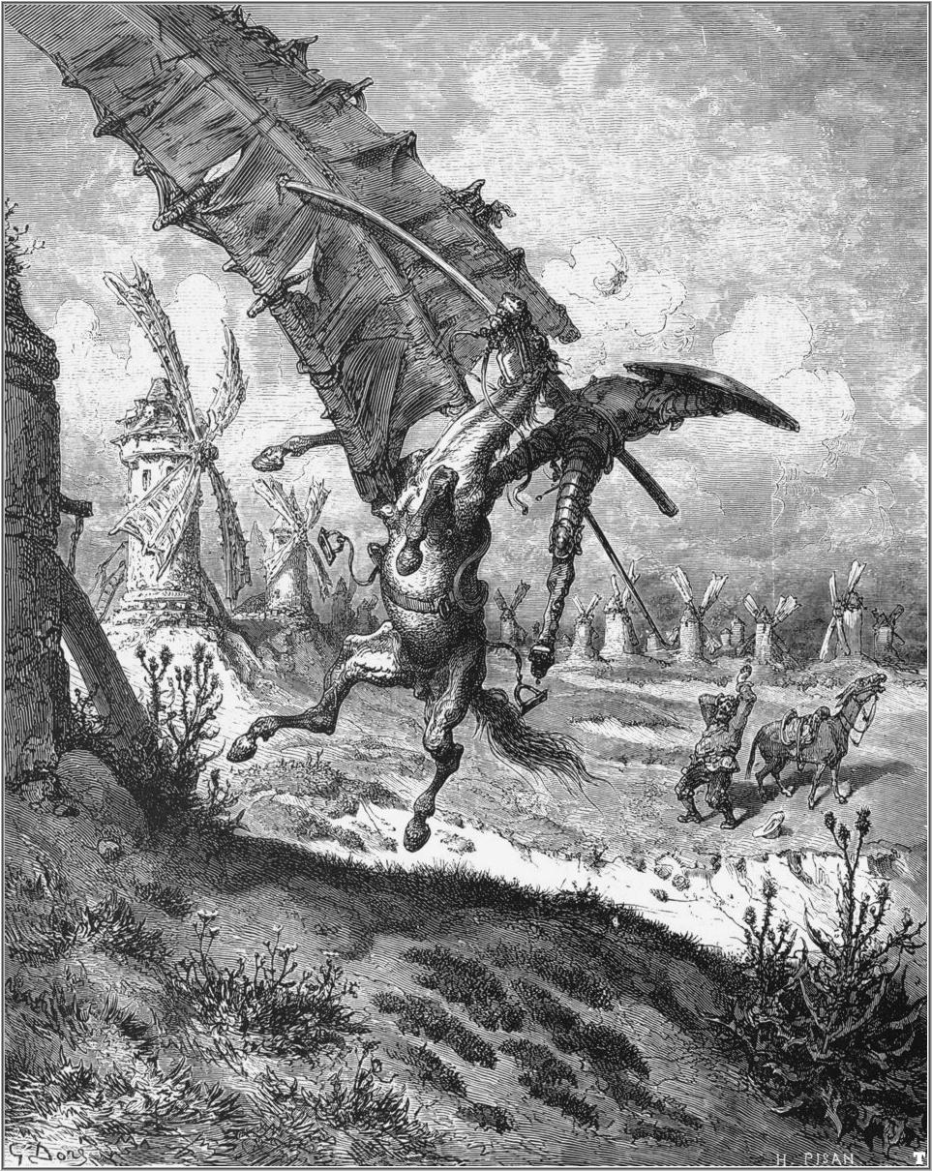

Ingenious Nobleman Sir Quixote of La Mancha
Quixotic, Quixotism.
tilting at windmills.
irrational idealism and optimism.
Notes:
https://upload.wikimedia.org/wikipedia/commons/7/75/Don_Quixote_6.jpg

Slide 29
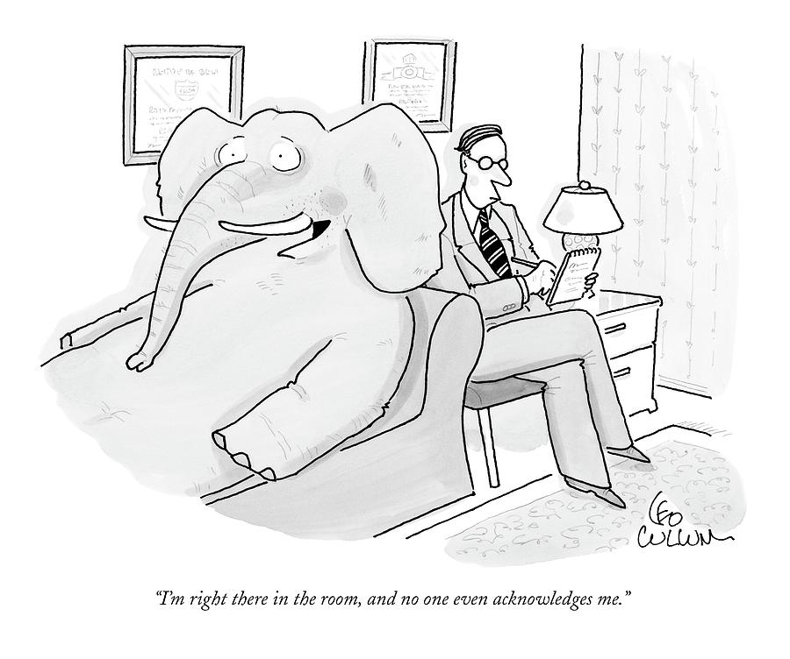
“I’m right there in the room, and no one even acknowledges me.”

Slide 30
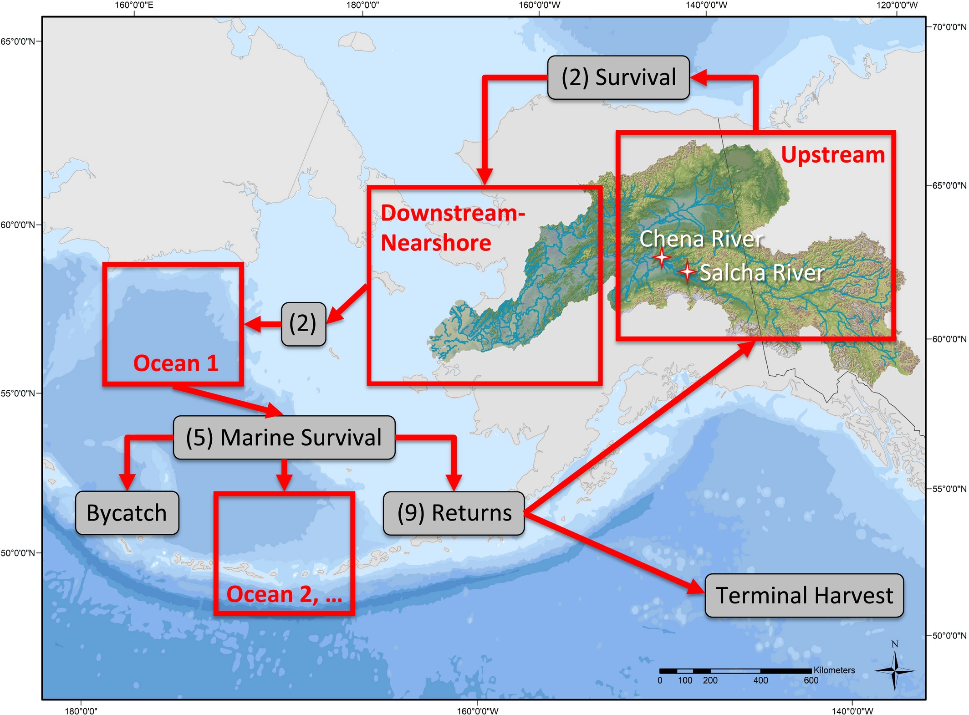
Notes:
Schematic map of the Yukon River Chinook salmon population dynamics model. Red boxes identify model stages and gray boxes describe stage transitions or removals from the system. Numbers in parenthesis reference model equations described in the text. It should be noted that red boxes describing model stages are meant to generally reflect model structure and spatial orientation, but do not reference the exact location of Chinook salmon at any given time. Curry J. Cunningham Peter A. H. Westley Milo D. Adkison. 2018. Signals of large scale climate drivers, hatchery enhancement, and marine factors in Yukon River Chinook salmon survival revealed with a Bayesian life history model. Global Change Biology 24(9):4399-4416. https://doi.org/10.1111/gcb.14315

Slide 31
“The impacts of future climate warming on Pacific salmon will be mixed, and context dependent.” Mantua, Crozier, Reed, Schindler, and Waples (2015).
Critical to remember:
(a) Statistical relationships between temperature and survival only represent the range of data observed. Nonlinear responses may exist outside the observed range;
(b) Relationships are limited to observed life stages. Survival of other life stages may be affected differently;
(c) future climate change will alter more than just temperature. Other habitat variables may have surprising impacts;
(d) climate‐mediated northward shifts marine species may result in increased predation; and
(e) temperature may only be a proxy for the actual driver of variations in survival.
Notes:
Mantua, Crozier, Reed, Schindler, and Waples (2015) that, “the impacts of future climate warming on Pacific salmon will be mixed, and context dependent”. While our results suggest increased survival with local and regional scale climate warming, it is critical to remember that: (a) these relationships only represent the range of data observed historically and may not fully capture potential nonlinear responses to temperature regimes outside the range of past observations, (b) temperature effects at other points in the lifecycle may have different effects on survival, (c) future climate change will alter aspects of marine and freshwater environments other than temperature, and changes in other habitat variables may have negative impacts, (d) climate‐mediated northward shifts in the distribution of marine species (Pinsky, Worm, Fogarty, Sarmiento, & Levin, 2013; Thorson, Pinsky, & Ward, 2016) may result in increased predation risk to juvenile and adult Chinook salmon, and (e) temperature may only be a proxy for the actual driver of survival variation.

Slide 32
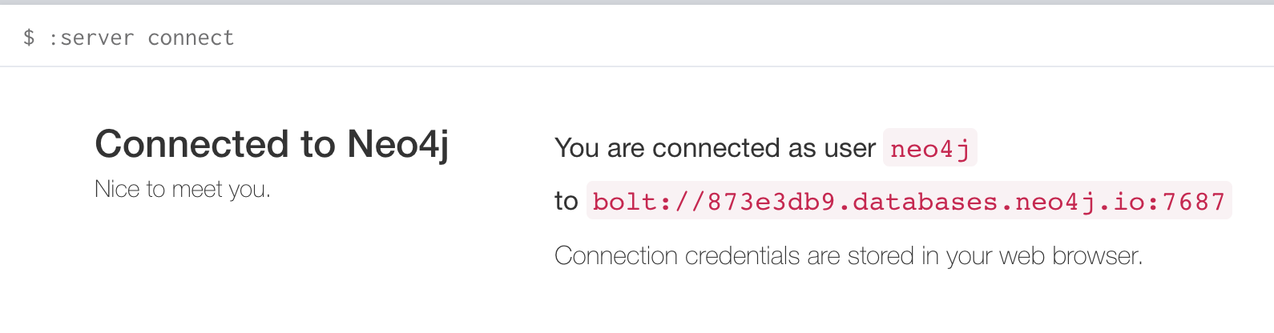
Notes:
Kurt Freytag
Dir. Product Management, Cloud @ Neo4j
+1 (415) 636-6095
https://console.neo4j.io/#databases
I named the db ISDL
accessed with ECLm6Xyr1gh1oVN7J3kKpWvf0g0zULjHOn4dWQ_jhGg
https://873e3db9.databases.neo4j.io/browser/
Reading https://neo4j.com/docs/operations-manual/3.4/authentication-authorization/native-user-role-management/
hmm, hmm, ...
CALL dbms.security.createUser('JohnSong', 'lkjh0987', true)
CALL dbms.security.addRoleToUser('admin', 'JohnSong’)
Seems to have worked. Very proud of myself.
Please take a look.
Noticed in license terms this expires in 6 months. Better than 3 days. Avoid pumpkin ~2019-May-15

Slide 33
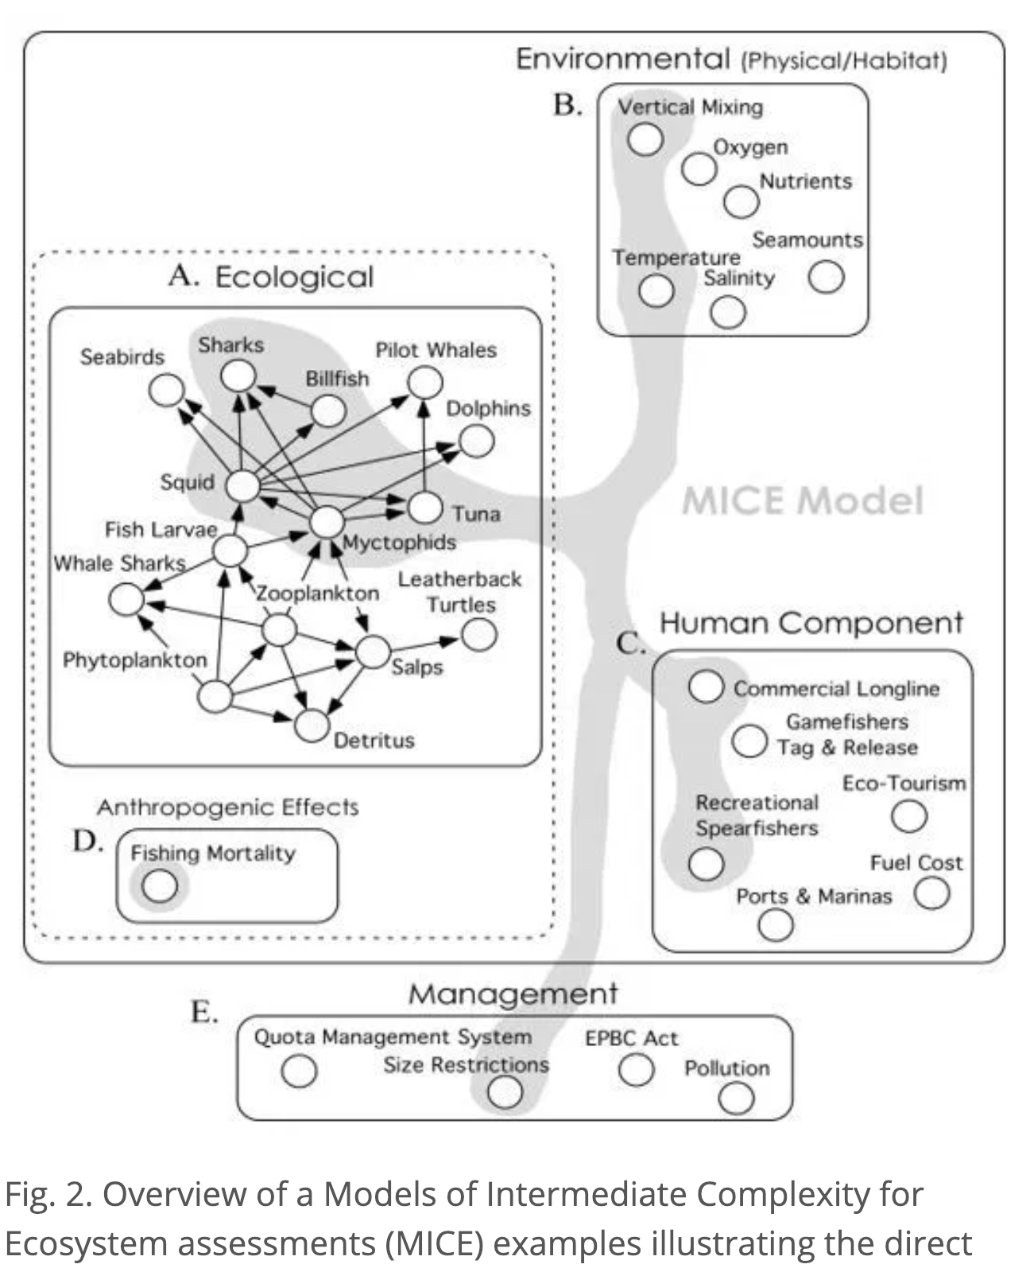

Slide 34
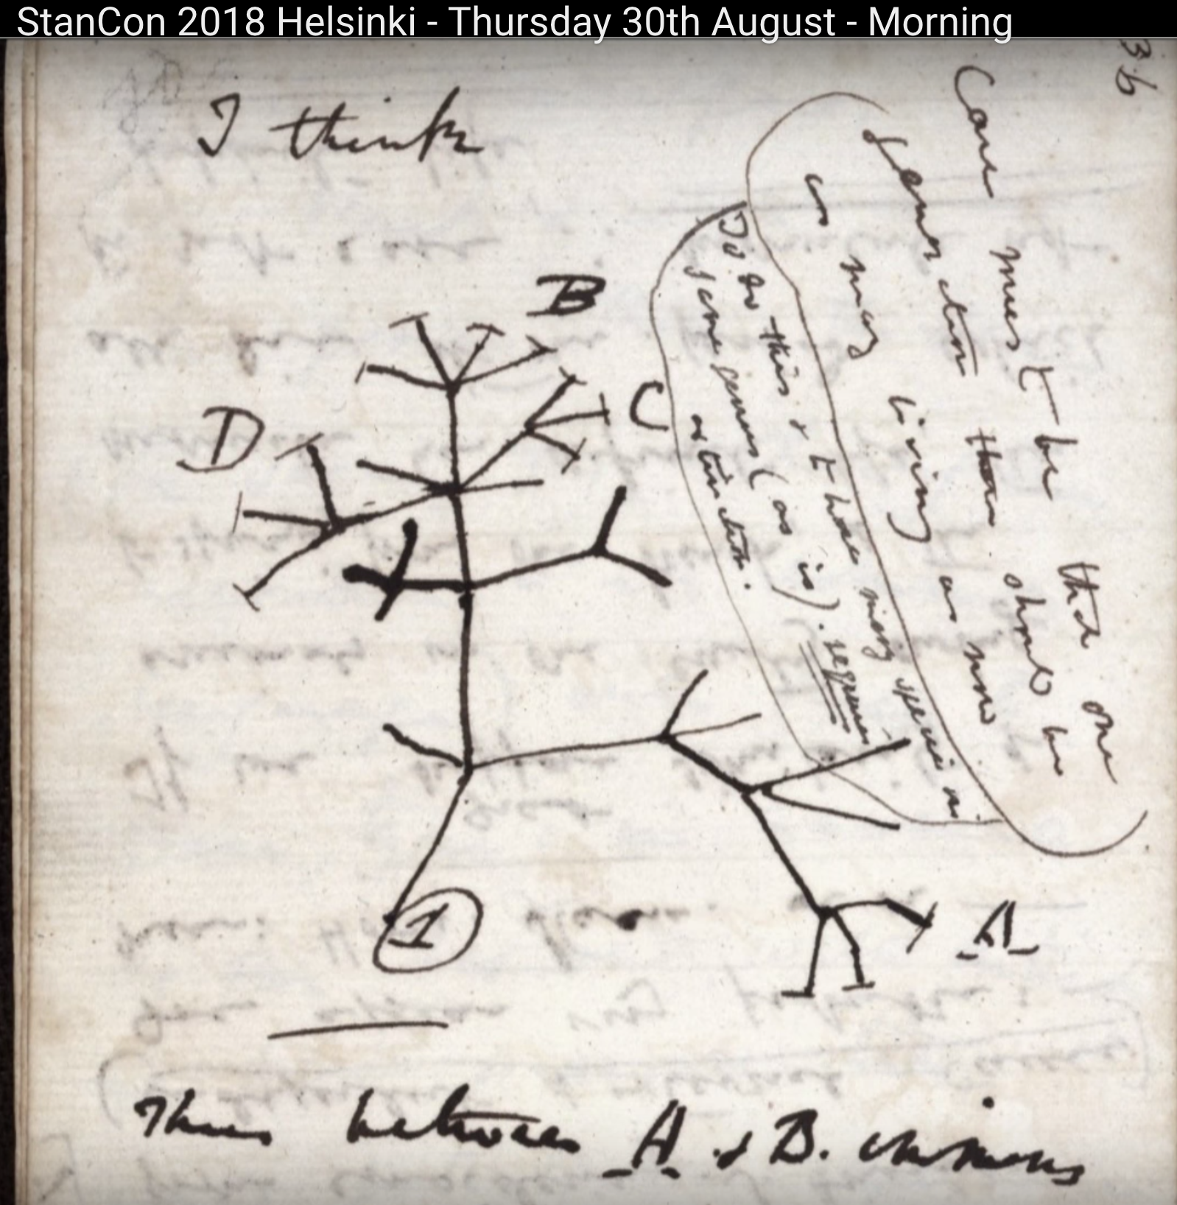
Notes:
Charles Darwin notes during voyage of the Beagle. He used a graph to discover phylogeny and evolution. Note he is looking at the path between species A and species B which is 7 links away.

Slide 36
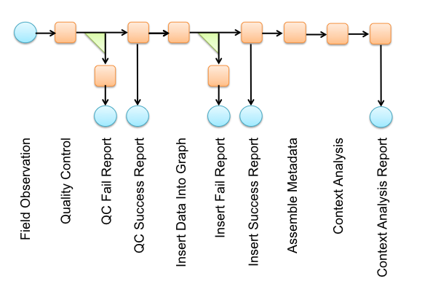

Slide 37
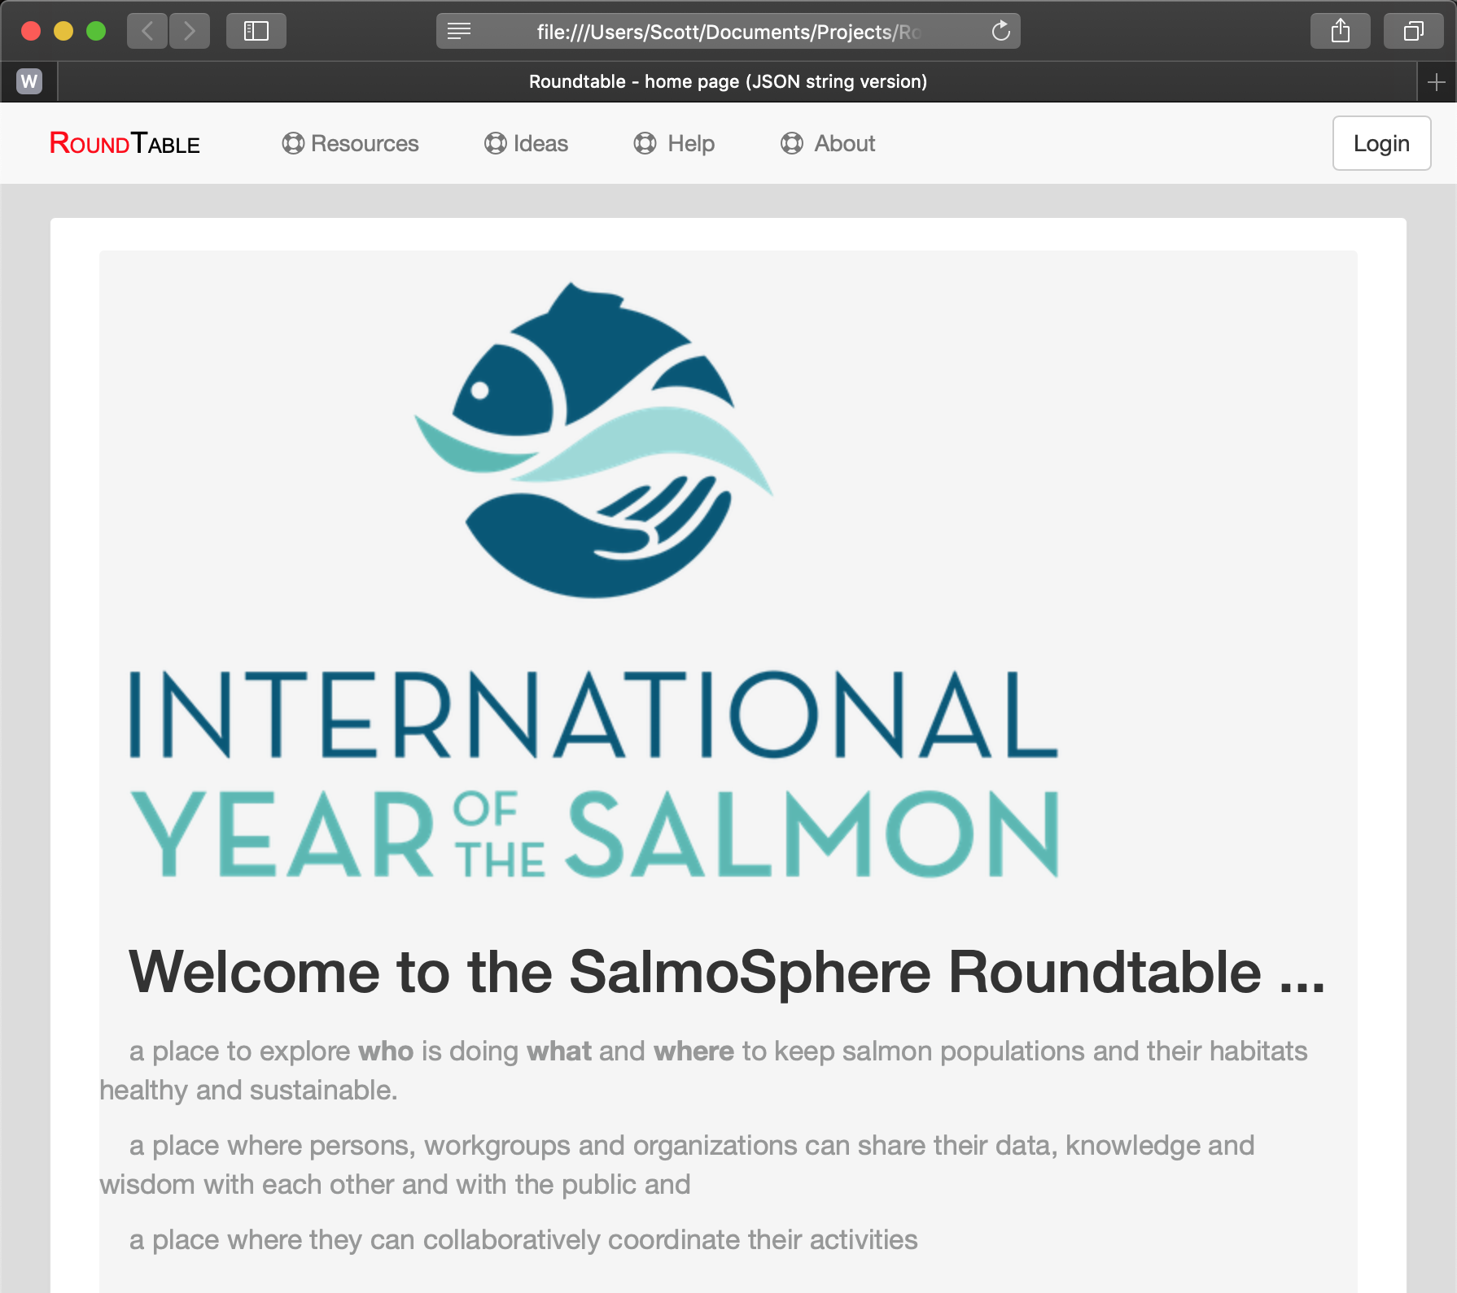

Slide 38
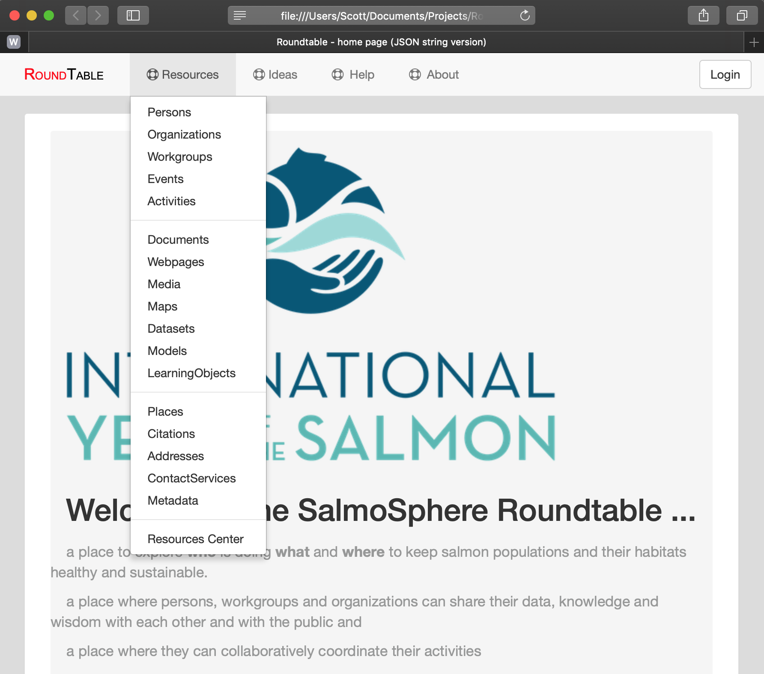

Slide 39
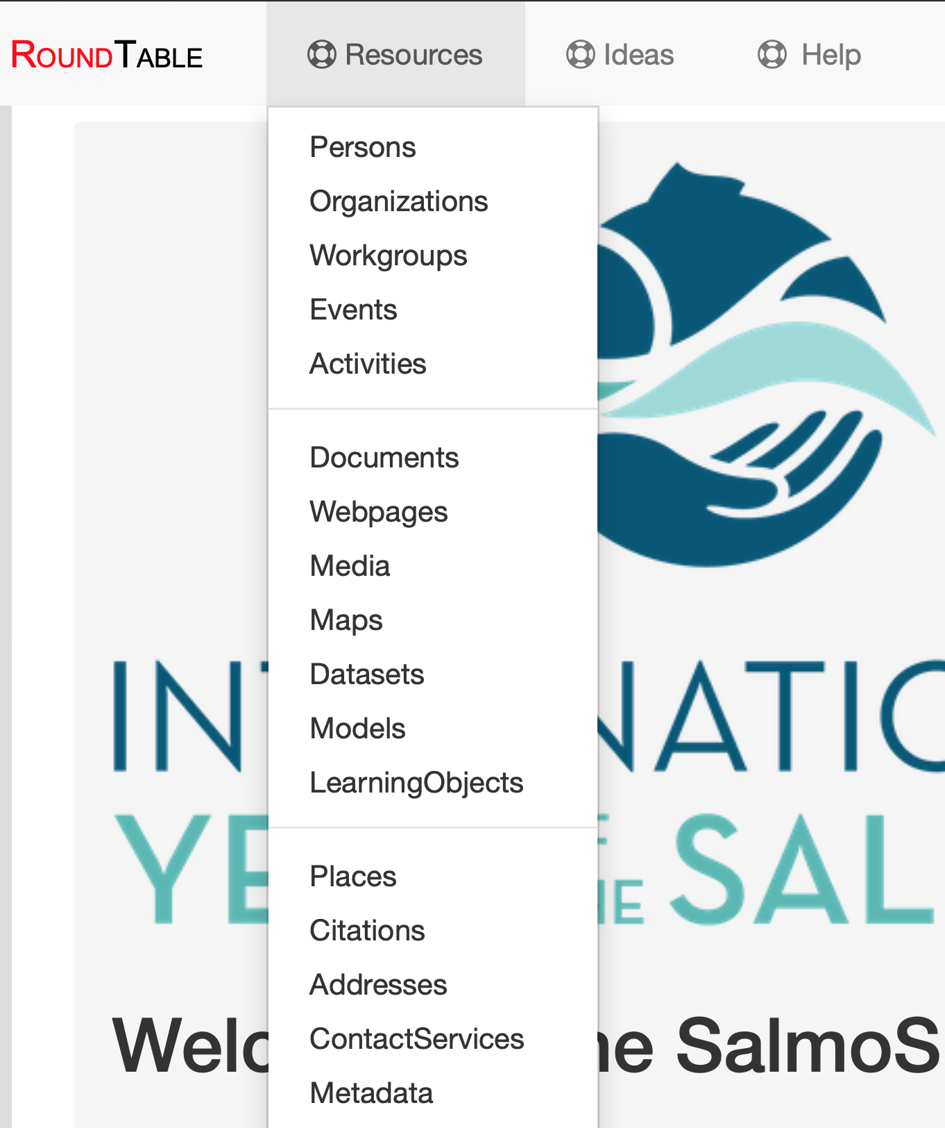

Slide 40
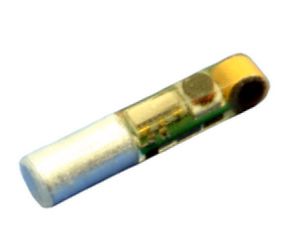
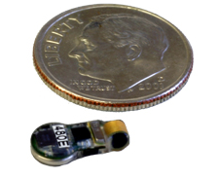
Internal Acoustic Tags 16 bit ID, 416.7 kHz, 156 dB, 744 microseconds 23 days @ 3 second between pings
15 x 3.4 x 3.4 mm
216 mg in air
10.7 x 5.0 x 2.8 mm
300 mg in air
Notes:
Pacific Northwest National Laboratory and Advanced Telemetry Systems, Inc.
The Juvenile Salmon Acoustic Telemetry System (JSATS) and its advanced decoder software that can track fish passage through dams and beyond, and also monitor fish behavior. PNNL developed the JSATS transmitters and battery to be so small it can be injected into young fish — eliminating the need to surgically implant a tag, which puts extra stress on a fish. The JSATS includes the smallest acoustic transmitters in the world. PNNL has also recently developed an even smaller tag technology that allows for research on the tiniest fish including juvenile eel and lamprey. "This new acoustic fish tag meets the Army Corps of Engineers' JSATS specifications and weighs less than one one-hundredth of an ounce," said Kuechle. "The JSATS technology is complementary to our long history offering innovative and cost-effective wildlife tracking products and we're proud to have supplied the devices to the Army Corps this year for an important study on the lower Snake River."

Slide 41
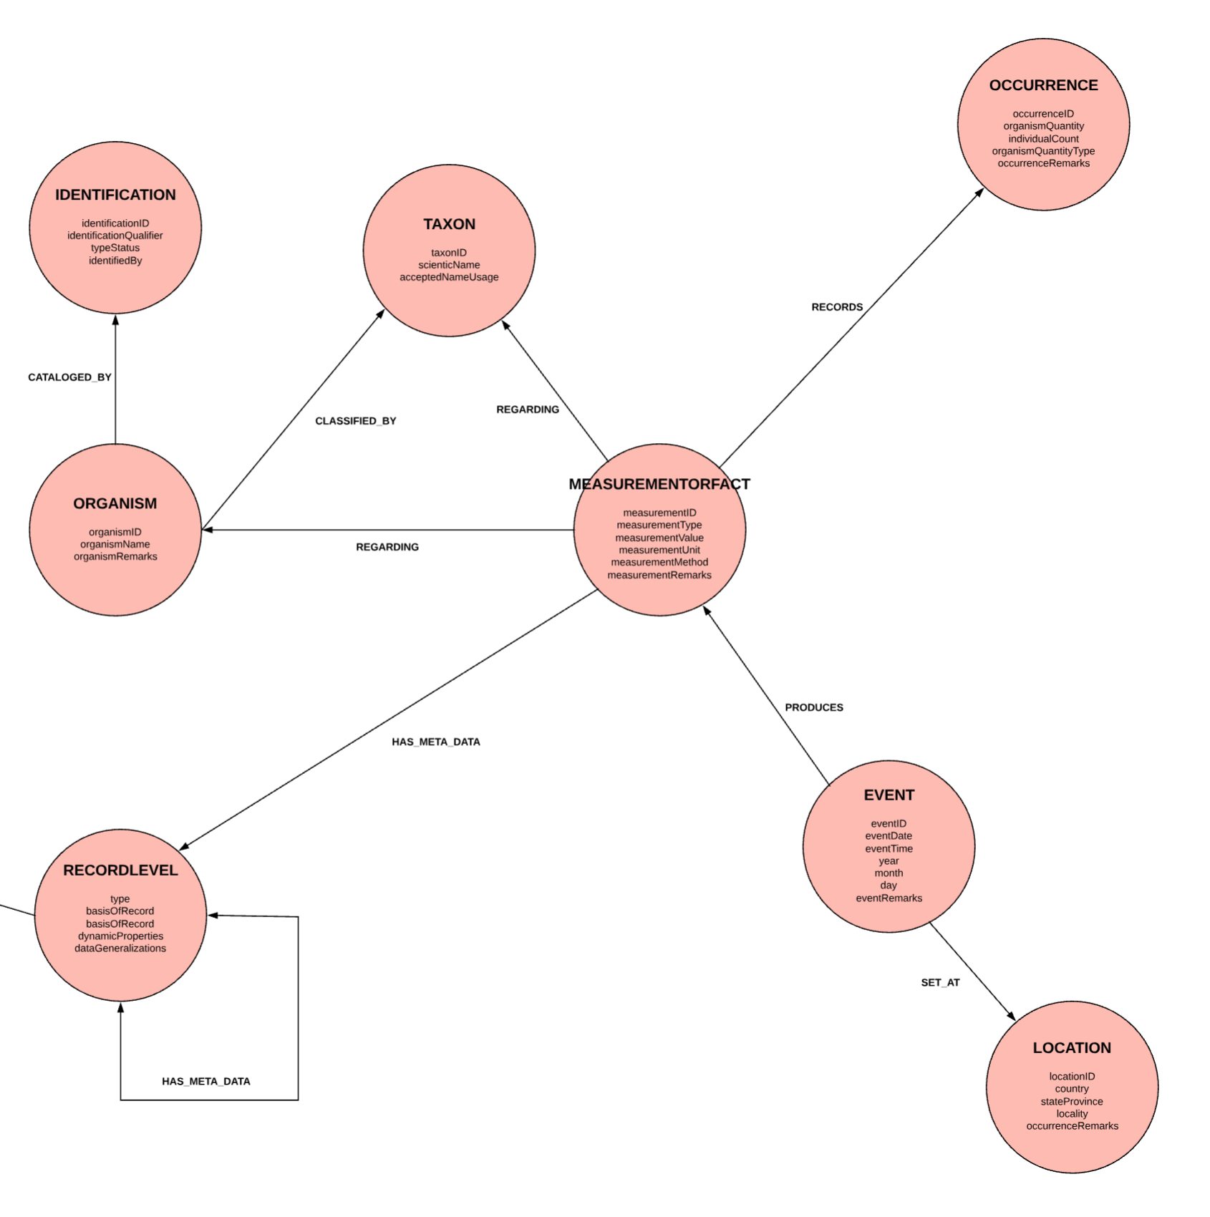
Notes:
From John Song. https://www.lucidchart.com/documents/edit/a9313e34-f6ca-4730-a17b-b591e0d7a725/0

Slide 42
Notes:
https://www.lucidchart.com/documents/edit/a9313e34-f6ca-4730-a17b-b591e0d7a725/0

Slide 43
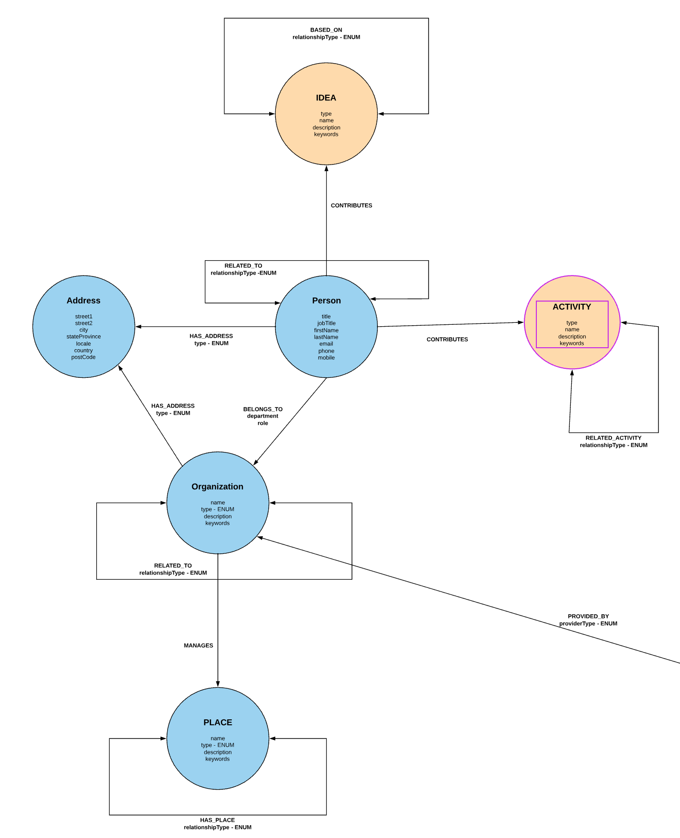
Notes:
From John Song. https://www.lucidchart.com/documents/edit/a9313e34-f6ca-4730-a17b-b591e0d7a725/0

Slide 44
MICE
Models of Intermediate Complexity for Ecosystem assessments
Notes:
MICE 2.png Fig.2 Overview of a “Models of Intermediate Complexity for Ecosystem assessments” (MICE)
Grey area is about fishing mortality (D).

Slide 45

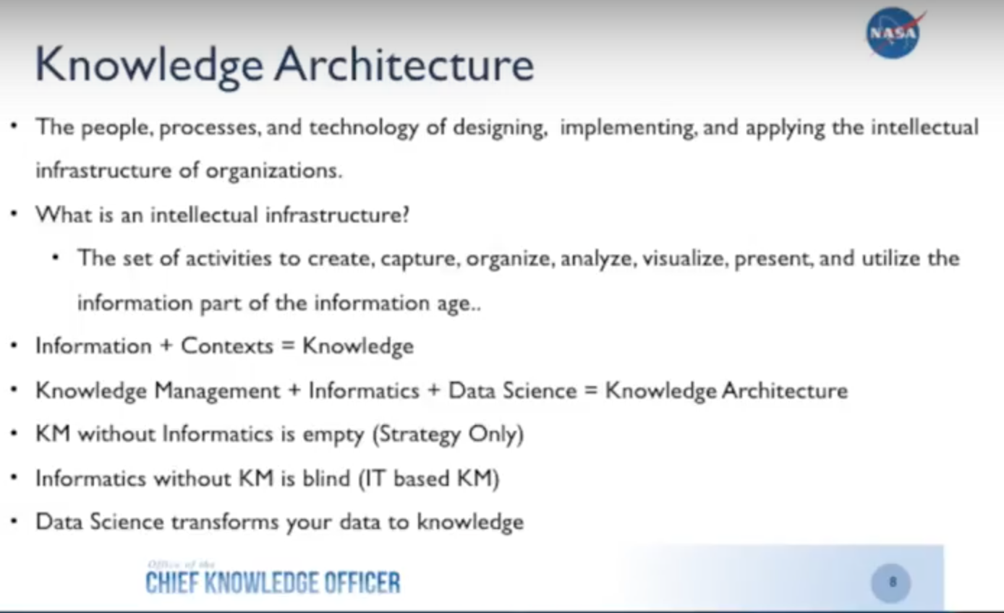
Notes:
Knowledge Architecture
The people, processes, and technology of designing, implementing, and applying the intellectual infrastructure of organizations.
Intellectual Infrastructure
The set of activities to create, capture, organize, analyze, visualize, present, and use the information of the information age.
Information + Context – Knowledge
Knowledge Management + Informatics + Data Science = Knowledge Architecture
KM without Informatics is empty: Strategy Only
Informatics without KM is blind: IT only
Data Science transforms your data into knowledge

Slide 46
Knowledge Architecture
The people, processes, and technology of designing, implementing, and applying the intellectual infrastructure of organizations.
Intellectual Infrastructure
The set of activities to create, capture, organize, analyze, visualize, present, and use the information of the information age.
Information + Context – Knowledge
Knowledge Management + Informatics + Data Science = Knowledge Architecture
KM without Informatics is empty: Strategy Only
Informatics without KM is blind: IT only
Data Science transforms your data into knowledge

Slide 47
Knowledge =
Information + Context
Knowledge Architecture =
Knowledge Management + Informatics + Data Science
Data Science transforms data into knowledge.

Slide 48
WISDOM
APPLICATION
KNOWLEDGE
CONTEXT
INFORMATION
STRUCTURE
DATA

